Slide 1
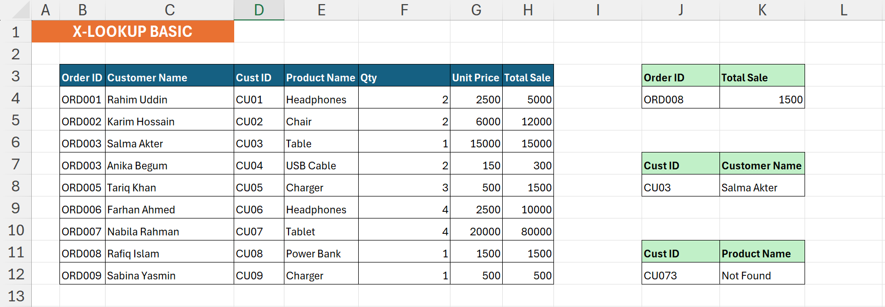
XLOOKUP Basic
See details →

Slide 2
XLOOKUP Basic Explanation
🎯 What I Did
Formula Used
Looked up Total Sale by Order ID, Customer Name by Cust ID, and tested a custom fallback message for a missing ID.
=XLOOKUP(J4, B3:B12,
H3:H12, "", 0)
=XLOOKUP(J8, D3:D12,
C3:C12, "", 0)
=XLOOKUP(J12, D3:D12,
E3:E12, "Not Found", 0)
⚙️ How It Works
XLOOKUP scans the lookup_array for the value, then returns the matching cell from return_array. The 4th argument defines what to show when no match is found.
💡 Key Insight
Setting the 4th arg to "Not Found" replaces the default #N/A error with a readable message.

Slide 3
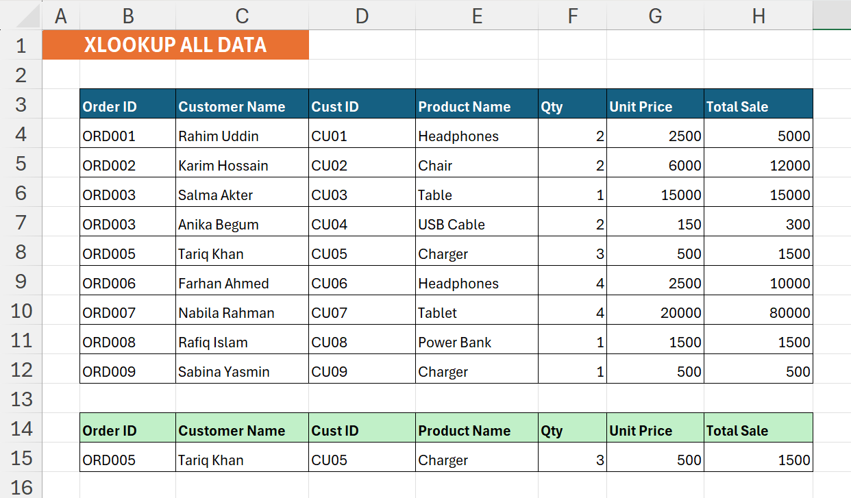
XLOOKUP - All Data
See details →

Slide 4
XLOOKUP - All Data Explanation
🎯 What I Did
Formula Used
Retrieved every field of an order record (all 6 columns) using a single Order ID as the lookup key.
=XLOOKUP(B15, B3:B12,
C3:H12, "", 0)
⚙️ How It Works
By passing a multi-column range (C3:H12) as the return_array, XLOOKUP spills the entire matched row automatically.
💡 Key Insight
No need to write separate formulas per column, XLOOKUP spills all fields at once.

Slide 5
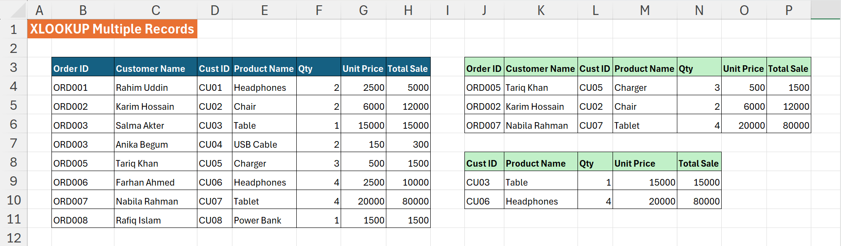
XLOOKUP - Multiple Records Match
See details →

Slide 6
XLOOKUP - Multiple Records Explanation
🎯 What I Did
Formula Used
Matched rows using two criteria simultaneously (e.g. Order ID + Customer Name, or Cust ID + Product Name).
=XLOOKUP(J4&K4,
$B$3:$B$11&$C$3:$C$11,
$D$3:$H$11)
=XLOOKUP(J9&K9,
$D$3:$D$11&$E$3:$E$11,
F3:H11)
⚙️ How It Works
Concatenating the lookup value and array columns creates a single virtual key column, enabling multi-condition lookup without helper columns.
💡 Key Insight
The & operator joins two arrays into one, a clean multi-criteria trick with no extra columns needed.

Slide 7
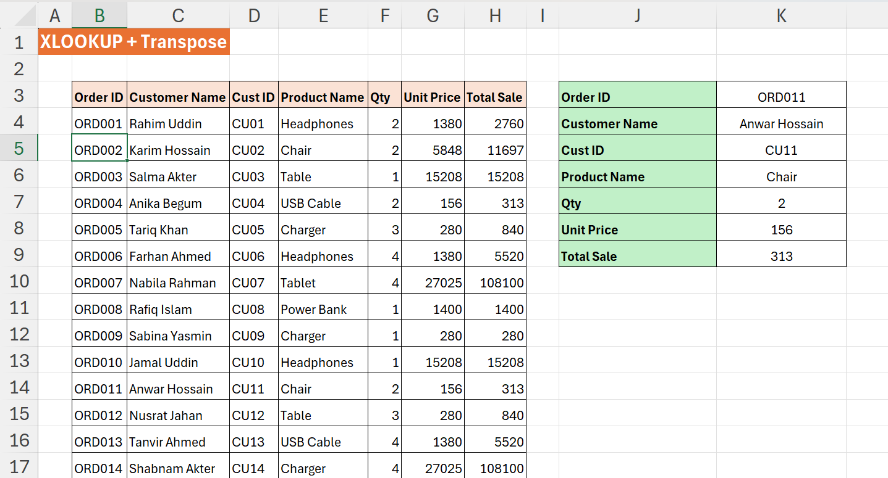
XLOOKUP + TRANSPOSE
See details →

Slide 8
XLOOKUP + TRANSPOSE Explanation
🎯 What I Did
Formula Used
Fetched a full order row and rotated it vertically, turning the horizontal result into a neat record card layout.
=TRANSPOSE(
XLOOKUP(K3,
$B$3:$B$19,
$C$3:$H$19)
)
⚙️ How It Works
XLOOKUP returns a horizontal array. Wrapping it in TRANSPOSE flips rows and columns, displaying each field on its own row.
💡 Key Insight
TRANSPOSE works on spilled arrays, combine it with XLOOKUP to build vertical profile cards instantly.

Slide 9
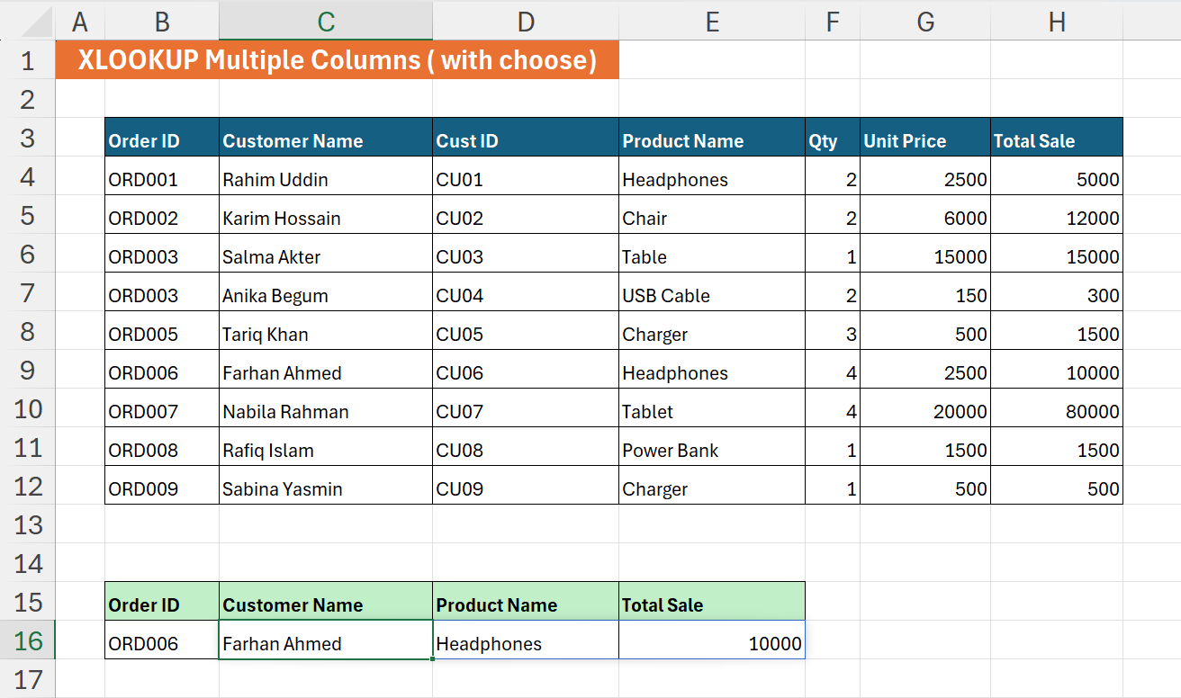
Multiple Columns - CHOOSE
See details →

Slide 10
Multiple Columns - CHOOSE Explanation
🎯 What I Did
Formula Used
Retrieved 3 non-adjacent columns (Customer Name, Product Name, Total Sale) for a given Order ID in one formula.
=XLOOKUP(B16, B3:B12,
CHOOSE({1,2,3},
C3:C12,
E3:E12,
H3:H12))
⚙️ How It Works
CHOOSE({1,2,3}, col1, col2, col3) builds a virtual 3-column array from any columns you pick, which XLOOKUP then searches and returns.
💡 Key Insight
CHOOSE with an array constant {1,2,3} lets you hand-pick any non-adjacent columns as the return range.

Slide 11
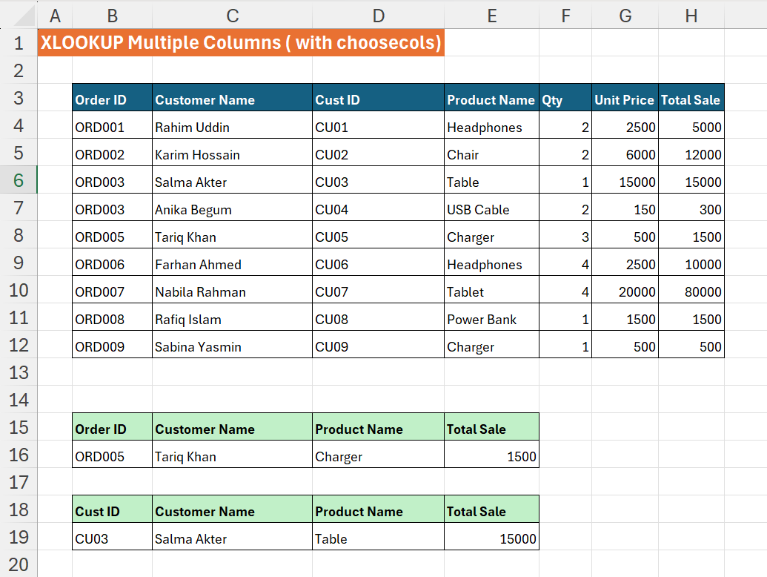
Multiple Columns - CHOOSECOLS
See details →

Slide 12
Multiple Columns - CHOOSECOLS Explanation
🎯 What I Did
Formula Used
Extracted columns 1, 3, and 6 from a full-row XLOOKUP result - once by Order ID and once by Cust ID.
=CHOOSECOLS(
XLOOKUP(B16, B3:B12,
C3:H12), 1, 3, 6)
=CHOOSECOLS(
XLOOKUP(B19, D3:D12,
C3:H12), 1, 3, 6)
⚙️ How It Works
CHOOSECOLS selects specific column positions from an array. It wraps the XLOOKUP result to keep only the columns you need.
💡 Key Insight
CHOOSECOLS is cleaner than CHOOSE when your return range is contiguous, just pass column position numbers.

Slide 13
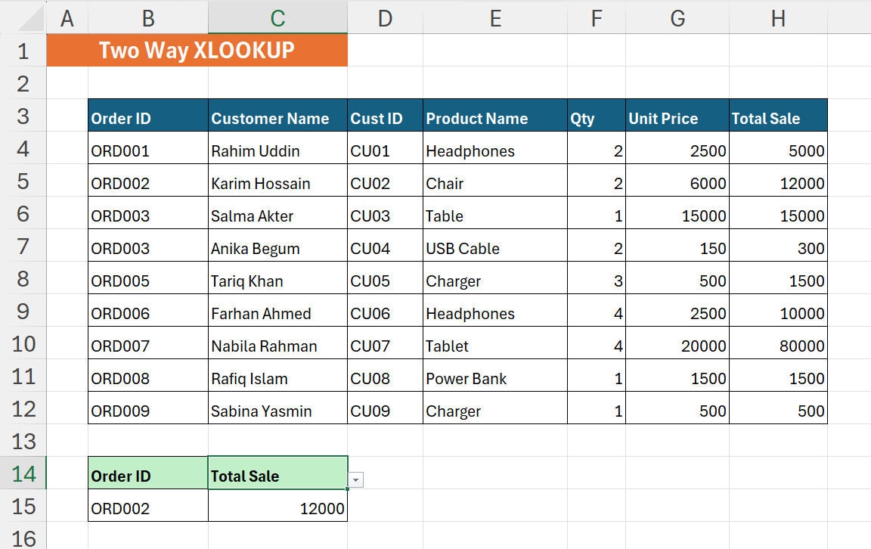
Two-Way XLOOKUP
See details →

Slide 14
Two-Way XLOOKUP Explanation
🎯 What I Did
Formula Used
Found the value at the intersection of a specific row (Order ID) and a specific column (e.g. Total Sale) - true 2D lookup.
=XLOOKUP(B15,
B3:B12,
XLOOKUP(C14,
B3:H3,
B3:H12))
⚙️ How It Works
The inner XLOOKUP finds the matching column range by header name. The outer XLOOKUP uses that result to find the right row.
💡 Key Insight
Nesting XLOOKUP in the return_array argument turns it into a dynamic 2D intersection formula.

Slide 15
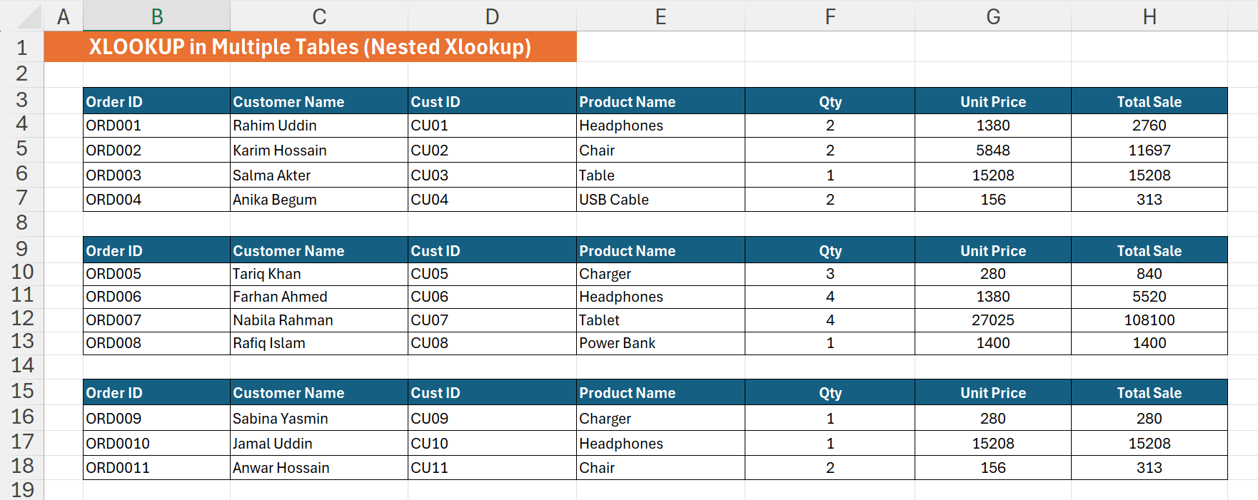
Nested XLOOKUP - Multiple Tables
See details →

Slide 16
Nested XLOOKUP - Multiple Tables Explanation
🎯 What I Did
Formula Used
Searched for an Order ID across 3 separate data tables, if not found in table 1, it automatically tried table 2, then table 3.
=XLOOKUP(B22,
B3:B7, C3:H7,
XLOOKUP(B22,
B9:B13, C9:H13,
XLOOKUP(B22,
B15:B18,
C15:H18)))
⚙️ How It Works
Each XLOOKUP is placed in the 4th (if_not_found) argument of the previous one, chaining the searches into a waterfall logic.
💡 Key Insight
The if_not_found argument is itself an XLOOKUP, this chains table searches without IF or IFERROR.

Slide 17
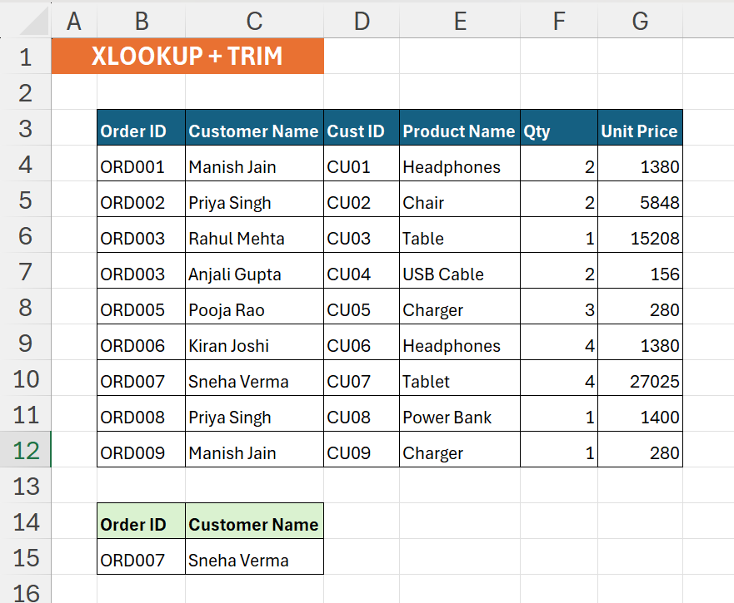
XLOOKUP + TRIM
See details →

Slide 18
XLOOKUP + TRIM Explanation
🎯 What I Did
{ } Formula Used
Handled dirty source data where Order IDs had invisible leading or trailing spaces that caused lookup failures.
=XLOOKUP(B15,
TRIM(B3:B12),
C3:C12)
⚙️ How It Works
Wrapping the lookup_array inside TRIM() cleans all whitespace on the fly during the lookup — no need to fix the source data.
💡 Key Insight
TRIM inside XLOOKUP is a real-world data cleaning technique — the source data stays untouched.

Slide 19
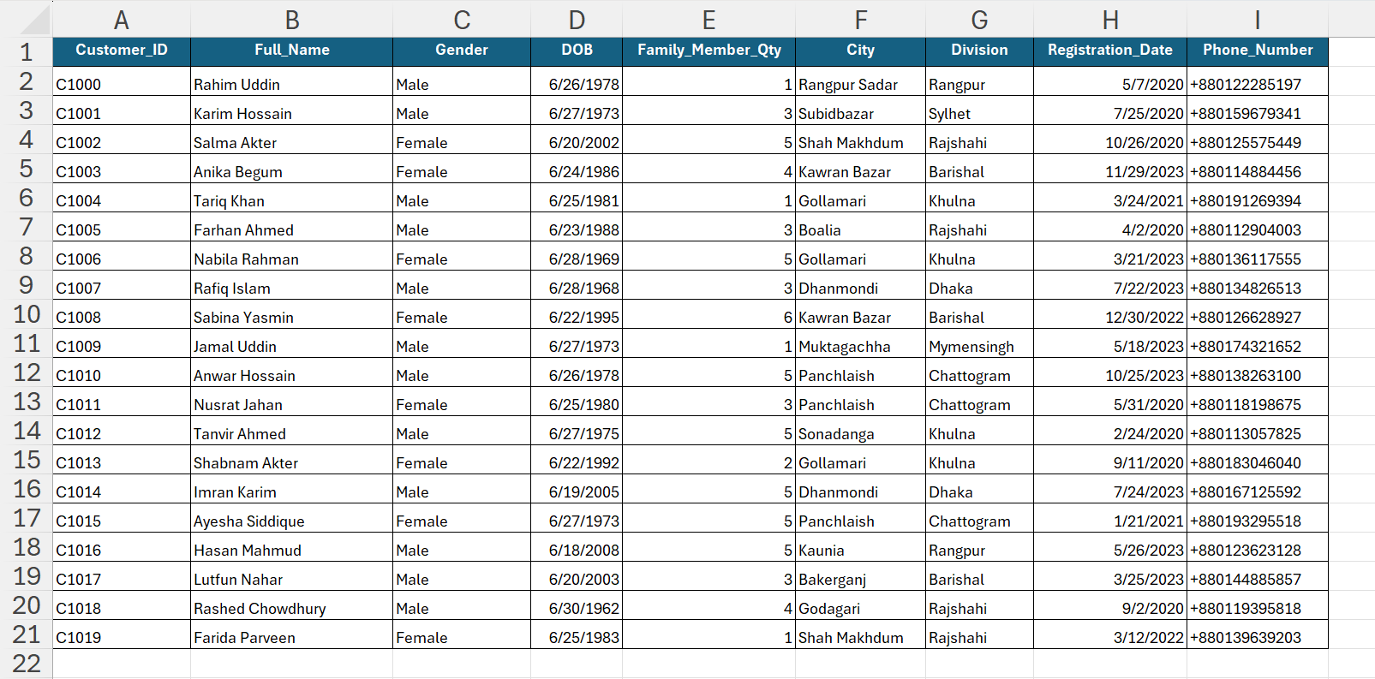
XLOOKUP - Phone Number Lookup

Slide 20
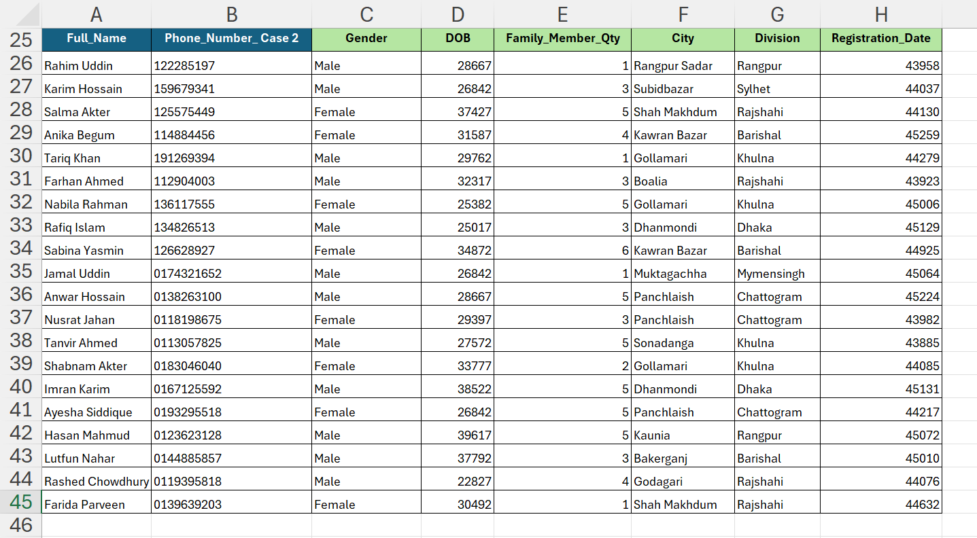
XLOOKUP - Phone Number Lookup Answer
See details →

Slide 21
XLOOKUP - Phone Number Lookup Explanation
🎯 What I Did
Formula Used
Looked up full customer details using only the last 9 digits of a phone number, bypassing country code format differences.
=XLOOKUP(
RIGHT(B26, 9),
RIGHT($I$1:$I$21, 9),
$C$1:$H$21)
⚙️ How It Works
RIGHT() extracts the last 9 characters from both the search value and the phone column, so +880 prefixes are ignored during matching.
💡 Key Insight
Applying RIGHT() inside both lookup arguments makes the formula resilient to inconsistent phone number formats.

